Slide 1

Scalars and Operators
Yifeng’s Python course

Slide 2
Variables
Variables are nothing but reserved memory locations to store values. This means that when you create a variable you reserve some space in memory.
Python variables do not need explicit declaration to reserve memory space.
The declaration happens automatically when you assign a value to a variable.
The equal sign (=) is used to assign values to variables.
Based on the data type of a variable, the Python interpreter allocates memory and decides what can be stored in the reserved memory.
A variable can change its type over the course of the program's execution.
By assigning different data types to variables, you can store integers, decimals or characters in these variables.

Slide 3
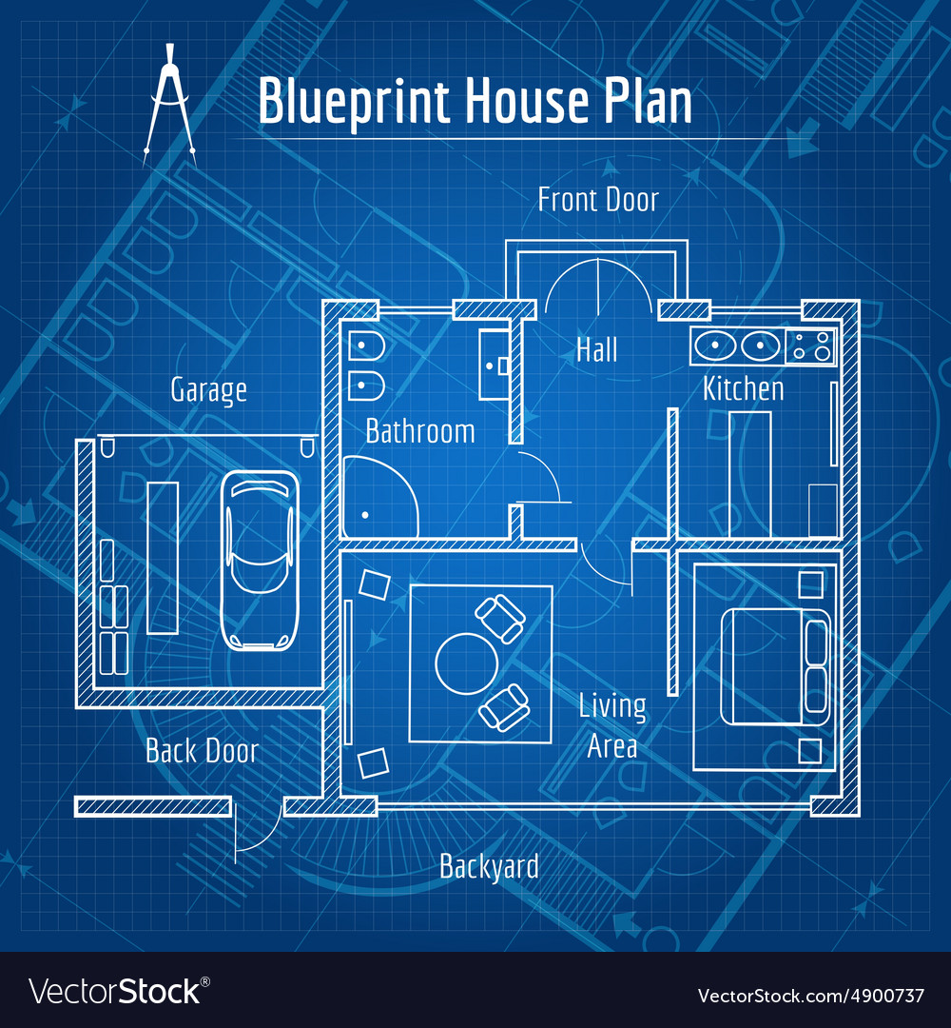


Metaphor
Variable: a piece of paper with an address on it
Object: A house
Class: A blueprint for building house

Slide 4
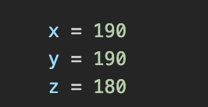
Variable and Object
EVERYTHING in Python is an object that has a specific class
A python variable is a symbolic name that is a reference or pointer to and object
Once an object is assigned to a variable, you can refer to the object by that name.
x
190
180
y
z

Slide 5
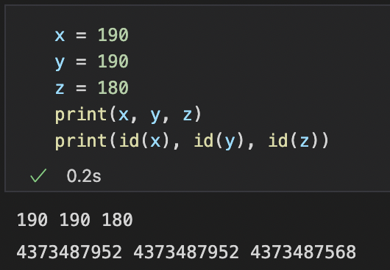
Object ID (Address)
The id() function returns a unique id for the specified object.
All objects in Python has its own unique id.
The id is assigned to the object when it is created.
The id is the object's memory address, and will be different for each time you run the program.
Syntax: id(object)
x
190
180
y
z

Slide 6
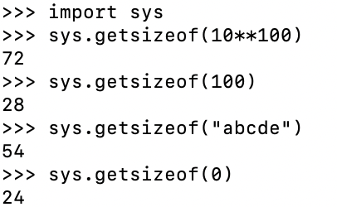
Size of an Object
sys.getsizeof()
Return the size of an object in bytes. The object can be any type of object. All built-in objects will return correct results, but this does not have to hold true for third-party extensions as it is implementation specific
Only the memory consumption directly attributed to the object is accounted for, not the memory consumption of objects it refers to.
It calls the object’s __sizeof__ method and adds an additional garbage collector overhead if the object is managed by the garbage collector.

Slide 7
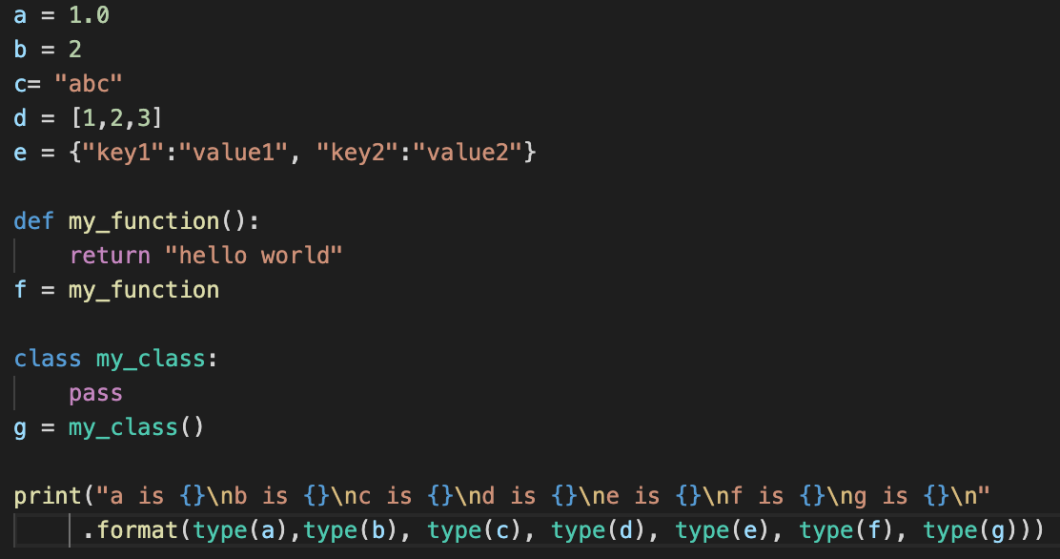
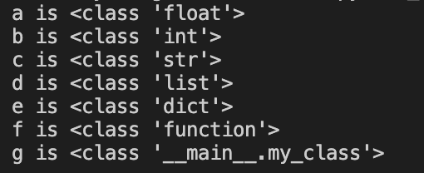
Type(class) of an Object
type(object)
The function either returns the type of the object or returns a new type object based on arguments passed
Output:

Slide 8
Data Structure
Data Structures are “containers” that organize and group data according to type
Data structures serve as the basis for abstract data types (ADT). The ADT defines the logical form of the data type.
Data structures provide a means to manage large amounts of data efficiently for uses such as large databases and internet indexing services.

Slide 9
Data Structure
Non-Primitive Data Structure: can hold multiple values either in a contiguous location or random locations
Arrays
Lists
Tuples
Dictionary
Sets
Files
Trees
…
Primitive Data Structure: Primitive data structure is a data structure that can hold a single value in a specific location
Integers
Floating point numbers
Complex numbers
String
Boolean

Slide 10
This lesson will focus on
Scalers
Integers
Floats
Boolean
Operators
Arithmetic Operators
Bitwise Operators (optional)
Identity Operators
Comparison Operators
Logical Operators
Assignment Operators
Membership Operators (next lesson)

Slide 11
Integers
An integer is a whole number that could hold a zero, positive or negative value.
Integers can be of any length, it is only limited by the memory available.
The following strings can be prepended to an integer value to indicate a base other than 10:
Prefix | Interpretation | Base
0b (zero + letter 'b') | Binary | 2
0o (zero + letter 'o') | Octal | 8
0x (zero + letter 'x') | Hexadecimal | 16

Slide 12
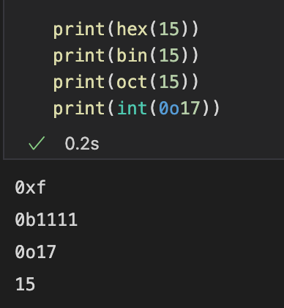
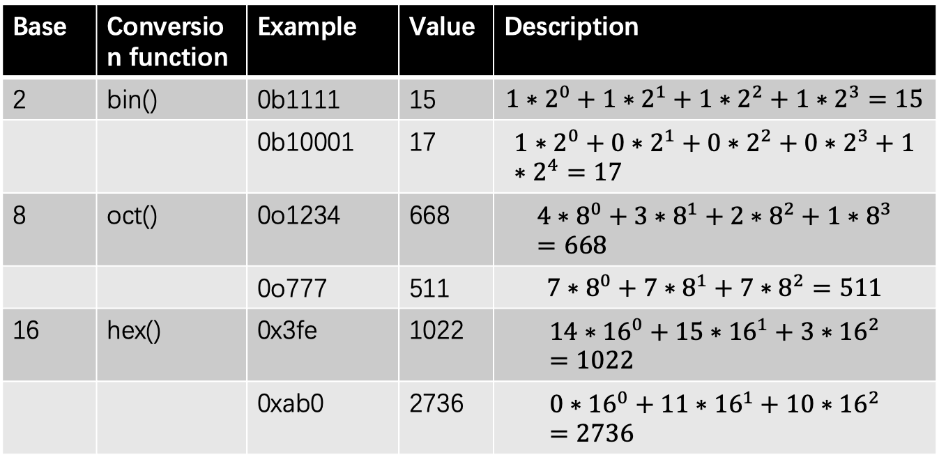
Base-2, Base-8. Base-16 (optional)
Base | Conversion function | Example | Value | Description
2 | bin() | 0b1111 | 15 | $$1∗2^{0}+1∗2^{1}+1∗2^{2}+1∗2^{3}=15$$
 |  | 0b10001 | 17 | $$1∗2^{0}+0∗2^{1}+0∗2^{2}+0∗2^{3}+1∗2^{4}=17$$
8 | oct() | 0o1234 | 668 | $$4∗8^{0}+3∗8^{1}+2∗8^{2}+1∗8^{3}=668$$
 |  | 0o777 | 511 | $$7∗8^{0}+7∗8^{1}+7∗8^{2}=511$$
16 | hex() | 0x3fe | 1022 | $$14∗{16}^{0}+15∗{16}^{1}+3∗{16}^{2}=1022$$
 |  | 0xab0 | 2736 | $$0∗{16}^{0}+11∗{16}^{1}+10∗{16}^{2}=2736$$

Slide 13
Arithmetic operators
Let x=5, y=2
Operator | Name | Example | Result
+ | Addition | x + y | 7
- | Subtraction | x - y | 3
* | Multiplication | x * y | 10
/ | Division | x / y | 2.5
% | Modulus | x % y | 1
** | Exponentiation | x ** y | 25
// | Floor division | x // y | 2

Slide 14
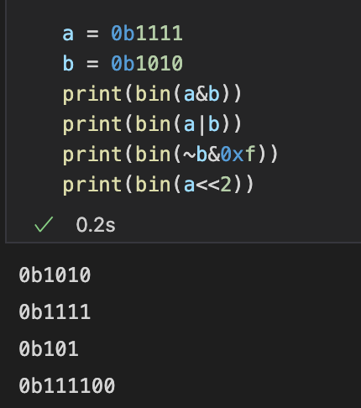
Bitwise Operators (optional)
Bitwise operators are used to compare binary numbers
Operator | Name | Description
& | AND | Set each bit to 1 if both bits are 1
| | OR | Set each bit to 1 if one of two bits is 1
^ | XOR | Set each bit to 1 if only one of two bits is 1
~ | NOT | Inverts all the bits
<< | Zero fill left shift | Shift left by pushing zeros in from the right and leftmost bits fall off
>> | Signed right shift | Shift right by pushing copies of the leftmost bit in from the left, and let the rightmost bits fall off

Slide 15
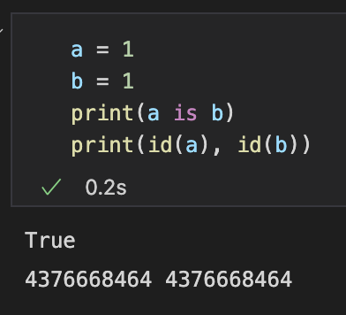
Identity Operators
Identity operators are used to compare the objects, not if they are equal, but if they are actually the same object, with the same memory location
Case sensitive
Operator | Description
is | Returns True if both variables are
is not | Return True if both variables are not the same object
Note: identity operators compares the id of objects.

Slide 16
Comparison Operator
Operator | Name | Example | Result
== | Equal | 3 == 2 | False
!= | Not equal | 3 !=2 | True
> | Greater than | 3 > 2 | True
< | Less Than | 3 < 2 | False
>= | Greater than or equal to | 3 >=3 | True
<= | Less than or equal to | 2 <= 3 | True

Slide 17
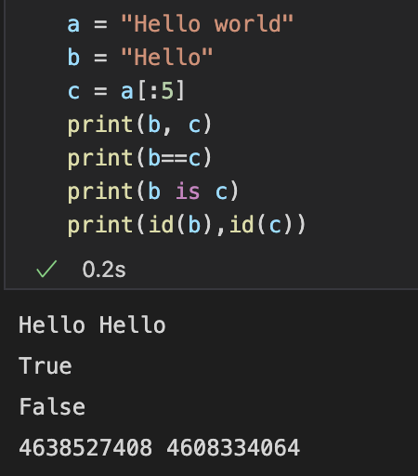
Identity vs comparison operator
In this example, both b and c has a value of “Hello”
“==“ compares the value between b and c
However, as b and c are stored in different memory addresses, “b is c” returns False

Slide 18
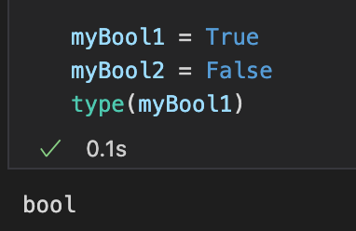
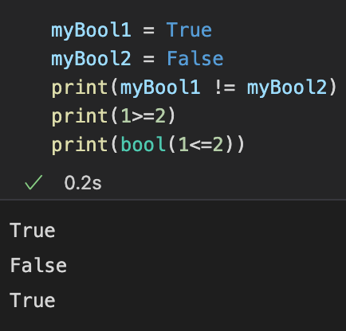
Boolean Type
The python data type `bool` is used to store two values i.e `True` and `False`.
Booleans are used to test whether the result of an expression is true or false.
A Boolean expression is an expression that evaluates to produce a result which is a Boolean value.
We can store a Boolean value in a variable
To check the boolean value of an expression or a variable, pass it as a parameter to the bool function:

Slide 19
Logical Operators
Logical operators are used to combine conditional statements
Priority: not > and > or
Case sensitive
Operator | Description | Example | Result
and | Returns True if both statements are true | 5>3 and 6>2 | True
or | Returns True if one of the statements is true | 3>=2 or 2<1 | True
not | Reverse the result, returns False if the result is true | not 3<2 | True

Slide 20
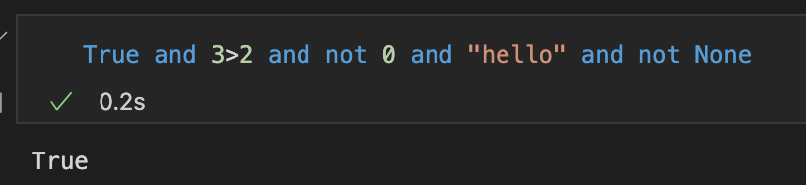
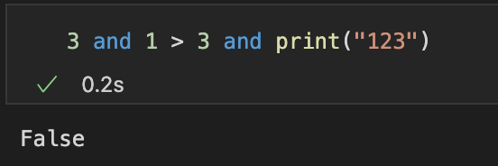
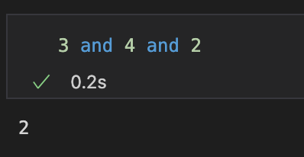
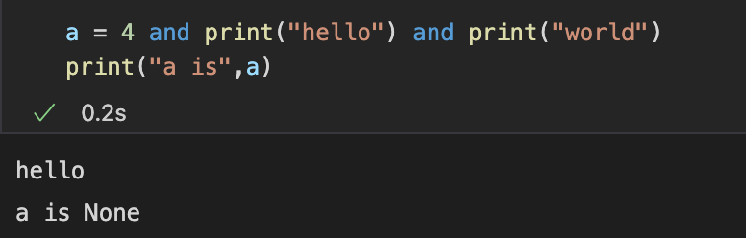
Examples (logical and)
Logical operators can be used for any objects
Logical AND statement run from left to right until a FALSE, 0, empty string or None is encountered
In this example, 1>3 returns false, so the print statement will not be executed
If all the statements is are True, it will return the last value
The function print() will return None, so the print(‘world’) statement will not be executed.

Slide 21
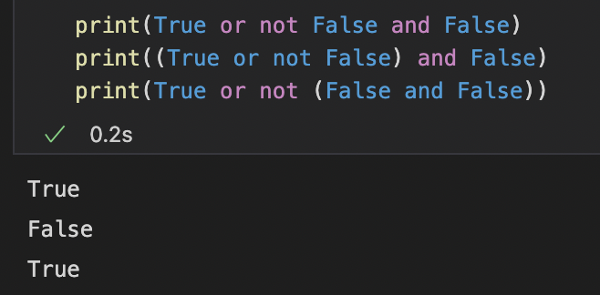
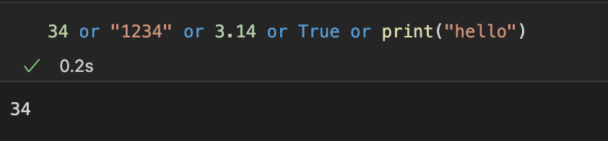
Examples (logical or)
Priority: not > and > or
In the first example, not is being evaluated First, then the and, and the or statement is calculated lastly.
True or not False and False
-> True or True and False
-> True or False
-> True
In the second example
(True or not False) and False
-> (True or True) and False
-> True and False
-> False
Similar to and, the program runs from left to right until it encounters a statement that is not False or empty

Slide 22
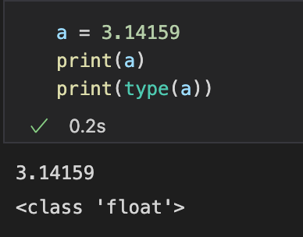
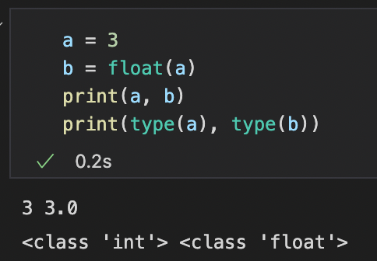
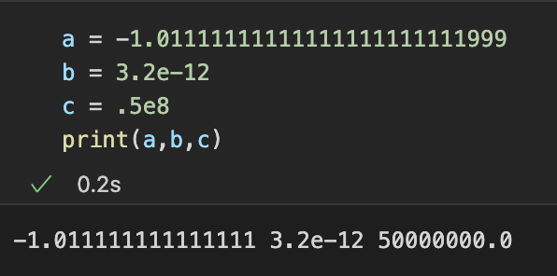
Float
The float type in Python designates a floating-point number.
Float values are specified with a decimal point.
A floating-point number is accurate up to 15 decimal places.
The character e or E followed by a positive or negative integer may be appended to specify scientific notation.

Slide 23
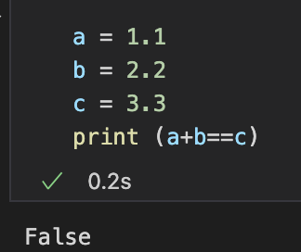

Something Weird？

Slide 24
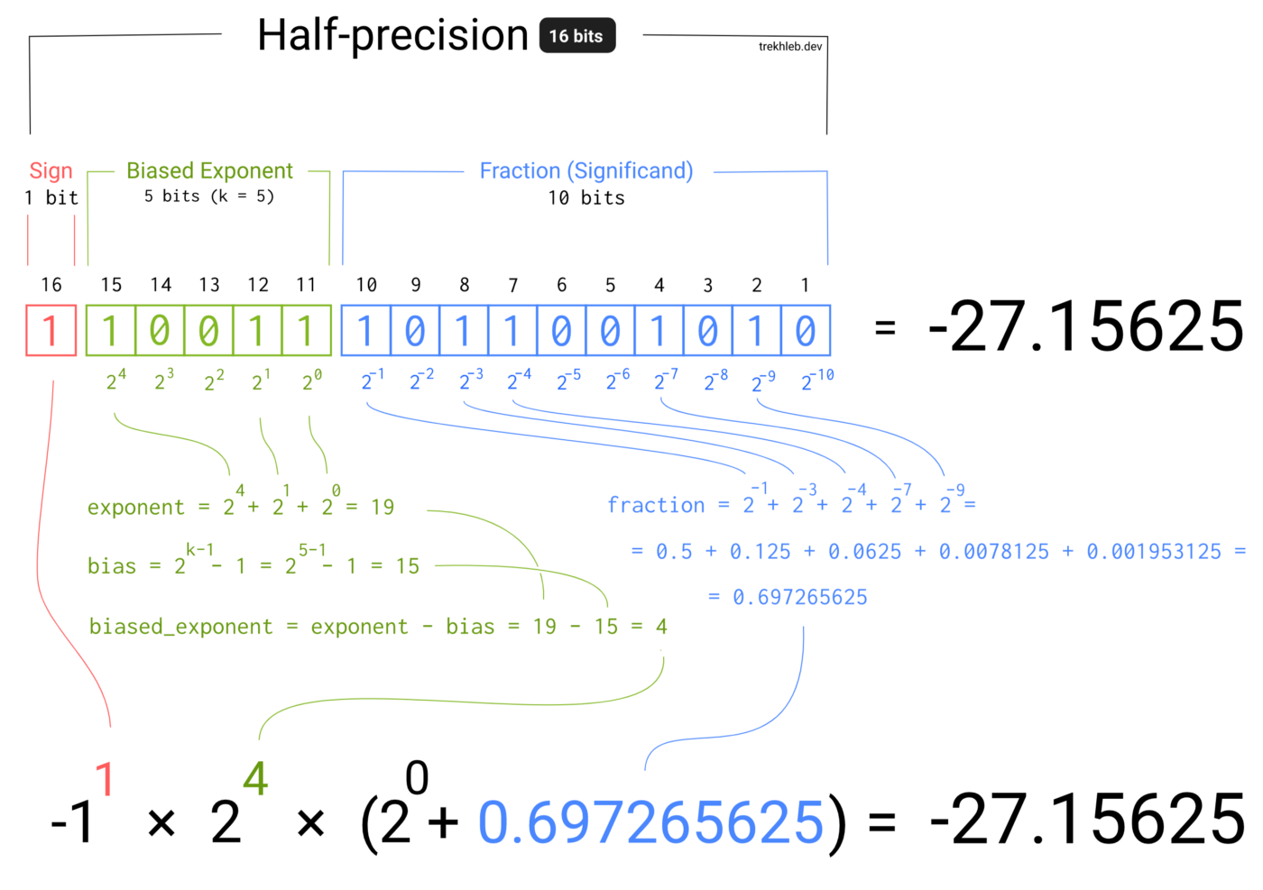
Something Weird？
It turns out that floating-point numbers are implemented in computer hardware as binary fractions as the computer only understands binary (0 and 1). Due to this reason, most of the decimal fractions we know, cannot be accurately stored in our computer.

Slide 25
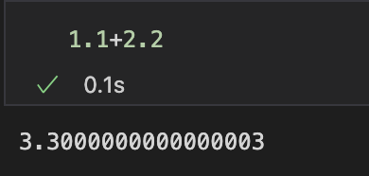
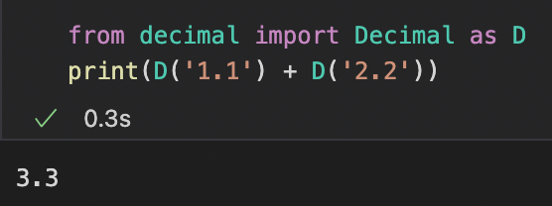
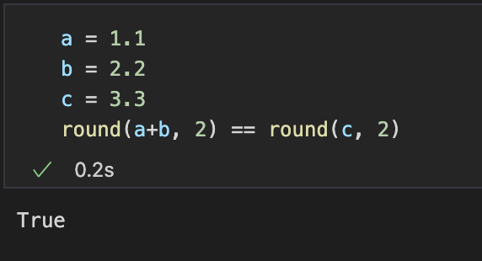
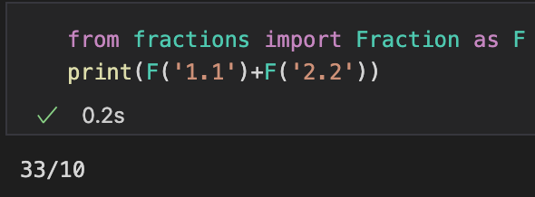
Fraction and Decimals

Slide 26
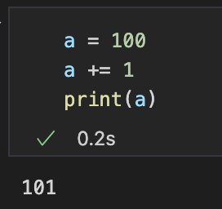
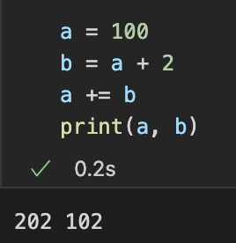
Assignment operators
Operator | Example | Same as
= | X=5 | X=5
+= | X+=3 | X = X+3
-= | X-=3 | X=X-3
*= | X*=3 | X=X*3
/= | X/=3 | X=X/3
%= | X%=3 | X=X%3

